Slide 1

Bangladesh Army University of Engineering & Technology
Department of Computer Science and Engineering
EEE 2261: Electrical Drives and Instrumentation
Winter 2025 Semester
Lecture-06
Course Teacher
S. M. Ashik Al Mashrafi
Lecturer, EEE, BAUET
Total Credit: 3.0 Credit Taking: 3.0

Slide 2
Course Content
Chapter | Topics
Introduction | Three phase circuits, alternators and transformers, principles & operation of DC Machines, synchronous, induction, universal and stepper motors, thyristor and microprocessor-based speed control of motors
Instrumentation Amplifiers | Differential, logarithmic, and chopper amplifiers, frequency and voltage measurements using digital techniques, recorders and display devices, spectrum analyzers and logic analyzers, data acquisition and interfacing to microprocessor-based systems;
Transducers | Terminology, types of transducers, principles and applications of photovoltaic, piezoelectric, thermoelectric, variable resistance and opto-electronics transducers. Noise reduction in instrumentation

Slide 3
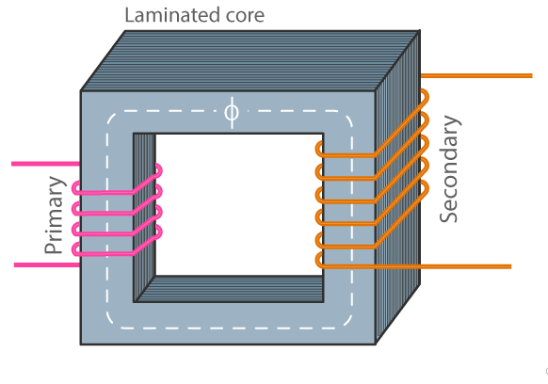
Transformer fundamental
A Transformer is a static electrical device that transfers the electrical energy from one electrical circuit to another electrical circuit through magnetic coupling without changing the frequency and power while changing the voltage and current level.
Fig. 1: Single phase transformer.

Slide 4
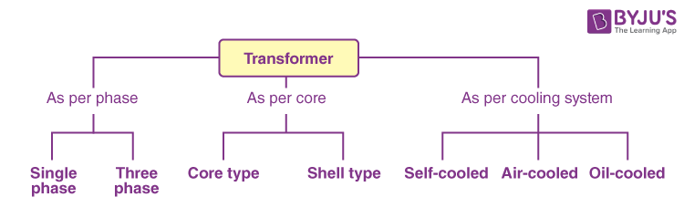
Types of Transformer
Fig. 2: Types of transformer (1).

Slide 5
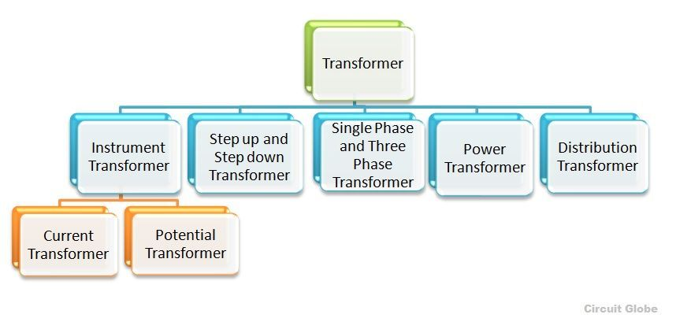
Types of Transformer
Fig. 3: Types of transformer (2).

Slide 6
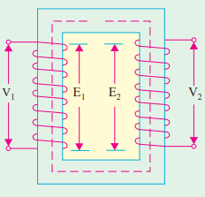
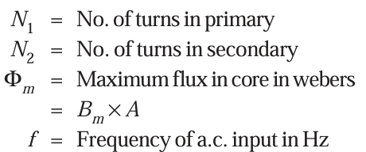
EMF Equation of a Transformer
r.m.s. value of the induced e.m.f. in the primary winding,
r.m.s. value of the induced e.m.f. in the secondary winding,
Fig. 4: Transformer.

Slide 7
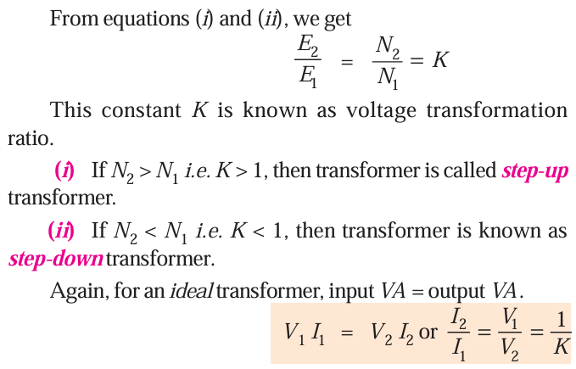
Voltage and Current Ratio of Transformation
Fig. 4: Transformer.

Slide 8
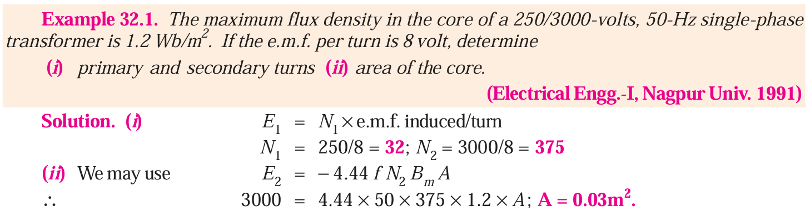
Mathematical Problem

Slide 9
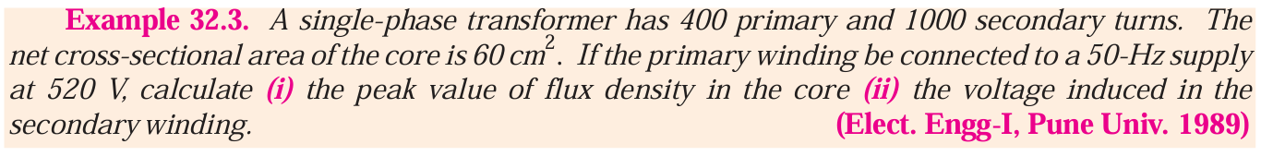
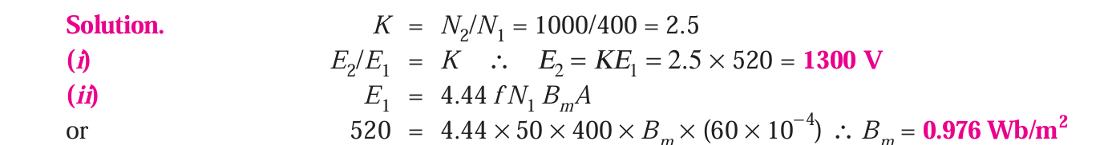
Mathematical Problem

Slide 10
Mathematical Problem (for practice)
SL No. | Name of the Book | Name of the Author (s) | Example
1 | A Text Book of Electrical technology | B.L Theraja | 32.4 32.5 32.6 32.7 32.8

Slide 11
Types of Losses in a Transformer
Transformer losses are mainly classified into two major types: (1) Iron loss in the core
(2) Copper losses in the windings
(*) Stray losses (minor loss)

Slide 12
Core Losses
These occur in the transformer core and are present even at no-load. Core losses depend mainly on voltage and frequency, not on load.
Hysteresis Loss Caused by repeated magnetization and demagnetization of the core due to alternating flux. Reduced by using silicon steel for the core.
Eddy Current Loss Alternating flux induces circulating currents (eddy currents) in the core. These currents cause I²R heating in the core. Reduced by laminating the core.

Slide 13
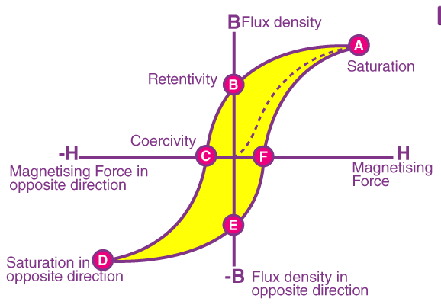
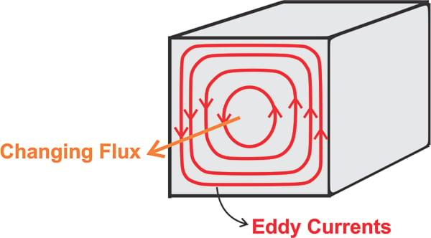
Core Losses
Fig. 5: Hysteresis loop.
Fig. 6: Eddy current.

Slide 14
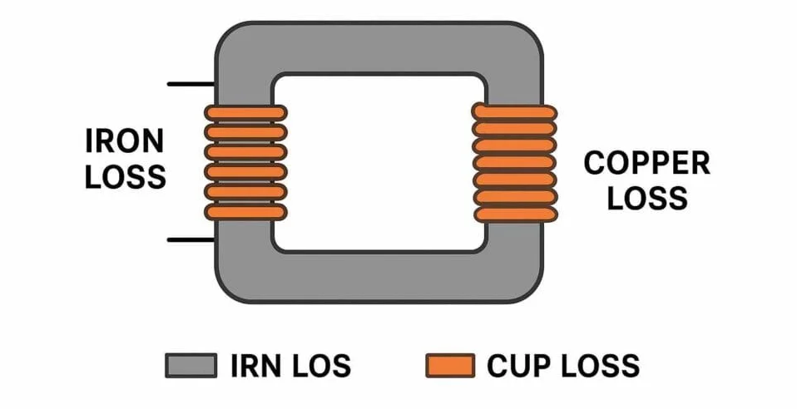
Copper Losses
Occur in the primary and secondary windings. Caused by the resistance of the windings.
Copper loss = I₁²R₁ + I₂²R₂
Depends on load current. Zero at no-load. Increases rapidly at heavy load
Fig. 7: Losses of transformer.

Slide 15
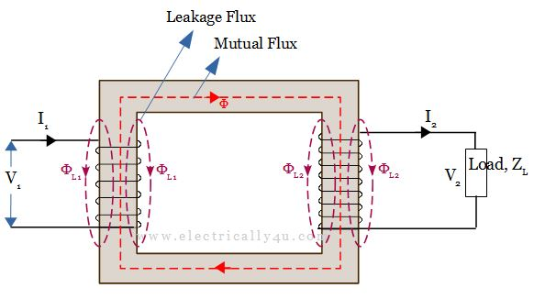
Minor Losses
Caused by leakage flux.
Leakage flux is the portion of magnetic flux produced by a transformer winding that does not link both the primary and secondary windings.
Fig. 8: Leakage flux.

Slide 16
Thank You
For Your Attention

